Slide 1
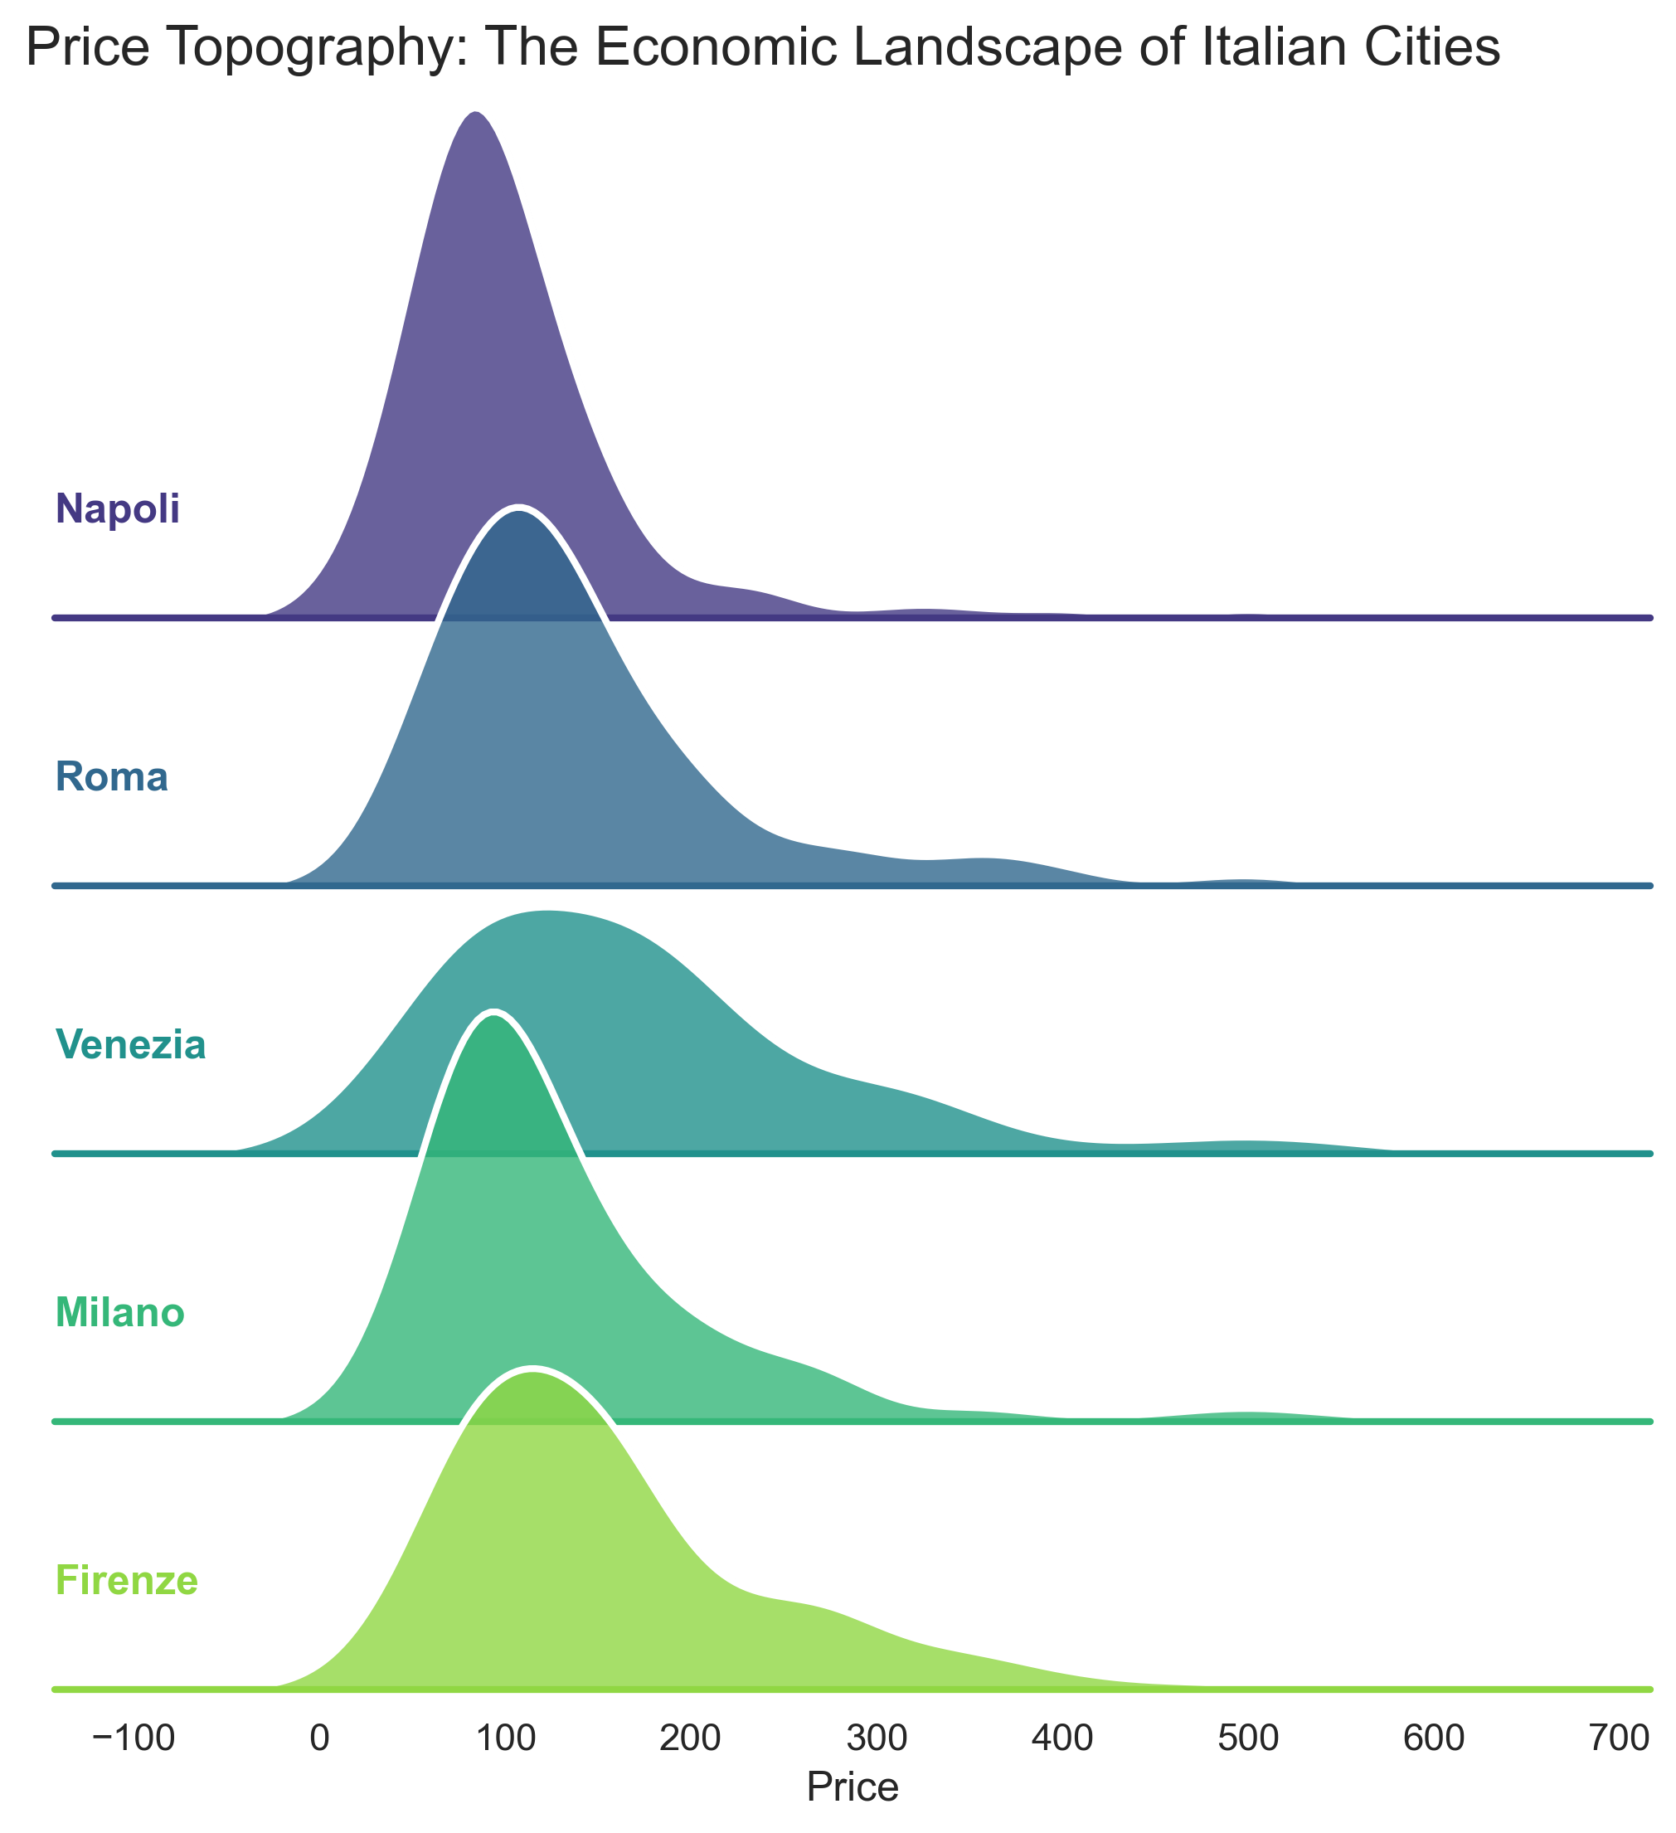
The Topography of Travel: An Economic Analysis of Italian Airbnbs
Student name: Muhammad Fahad
Student ID: 948477
Email : m.fahad5@campus.unimib.it

Slide 2
Research questions
Beyond physical property characteristics (size, room type), what are the hidden structural drivers that determine listing prices in the Italian short-term rental market?
The "Brand" Effect: “How strictly is wealth concentrated within specific 'Luxury Enclaves' (Neighborhoods), and does this create a 'Location Premium' that defies city-wide averages?”
The "Time" Arbitrage: “How does seasonality impact pricing volatility across different cities (e.g., Leisure vs. Business hubs), and where can travelers find the best value-for-money?”

Slide 3
About Data
Dataset Chosen: Italian Airbnb Listings Dataset (airbnbitaly_dm.csv).
Source: Aggregated rental data (Simulated/Public Domain for academic use).
Initial Considerations: "The raw data contained over 280,000 rows. My primary concern was the presence of extreme outliers (luxury villas priced at €5,000+) which skewed the averages and made standard visualizations unreadable.“
Data Quality & Cleaning:
          Encoding Issues: Handled Latin-1 character encoding to correctly preserve Italian city names (e.g., Venezia vs Venice).
Filtering: Removed inactive listings (0 reviews) and extreme outliers (Price > €600) to focus analysis on the "accessible" travel market (approx. 95% of data).
Normalization: Grouped data by Neighborhood and Season to allow for macro-level comparisons rather than individual listing analysis.

Slide 4
Methodology
Data Cleaning:
                Removed rows with missing coordinates or 0 reviews (inactive).
                Aggregated data by Neighborhood and City to analyze macro trends.
                Filtered outliers (>€600) to normalize for the standard market.
Merging:
Simulated a multi-source process by enriching the raw data with OpenStreetMap API data (Museums/Restaurants).
Merged these spatial counts onto the master dataset using KDTree algorithm
Software Used:
  Python (Pandas for manipulation, Matplotlib/Seaborn for static charts) and OpenStreetMap API (for geospatial enrichment). Code available at GitHub
  PowerPoint/Canva for final narrative layout and design.

Slide 5
Insights from the Data
The "Luxury Enclave" Phenomenon: Wealth is not evenly distributed. It is highly concentrated in specific historic districts (e.g., San Marco in Venice, Brera in Milan). These "Micro-Climates" command prices 2x higher than the national average.
The Volatility of Venice: Venice exhibits extreme price elasticity. It is the most expensive city in "Early Summer" but crashes to become affordable in "Early Winter.“
The Stability of Milan: Unlike leisure destinations, Milan shows remarkably stable pricing year-round, reflecting its nature as a business/industrial hub less reliant on seasonal tourism.
Strategic Implication: Smart travelers can "beat the market" by shifting travel dates (Time Arbitrage) or moving just outside top-tier neighborhoods (Location Arbitrage).

Slide 6
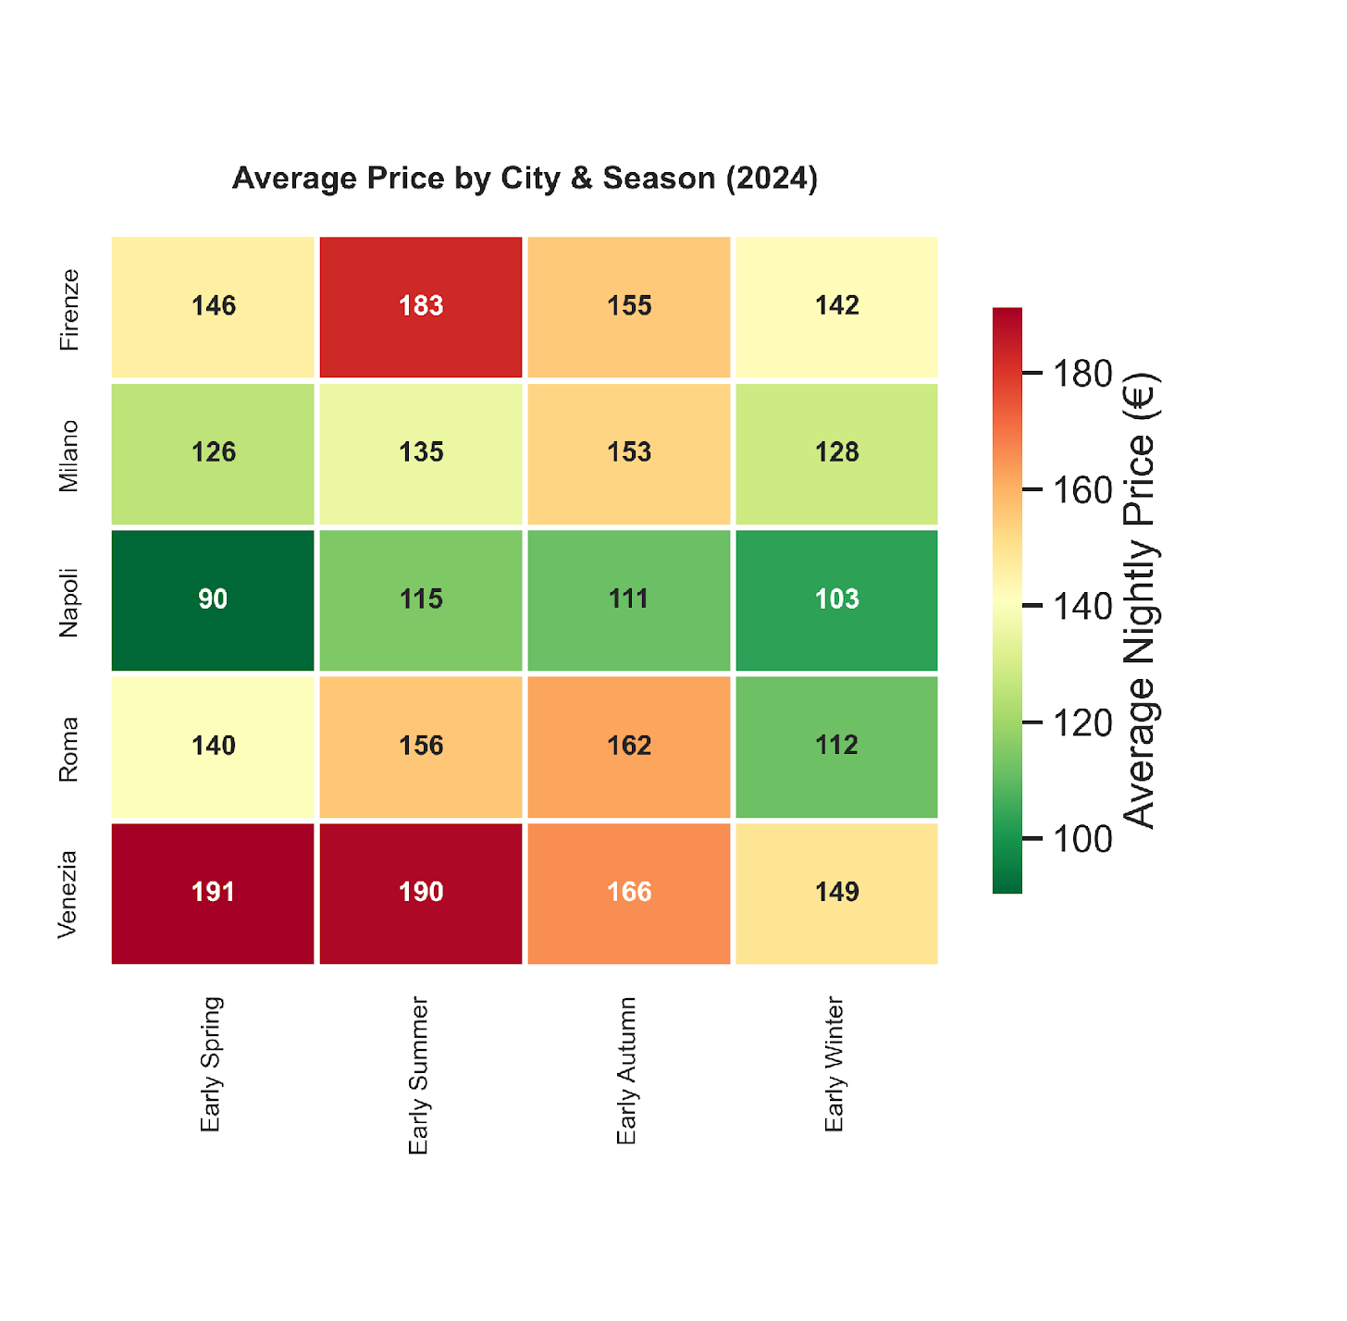
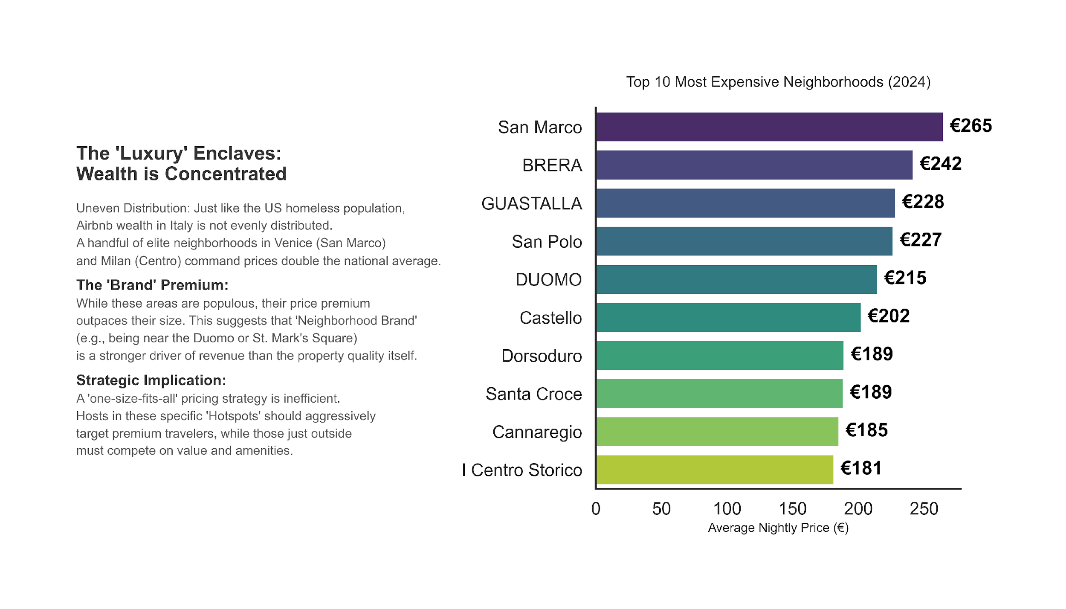
Timing the Market:
The Seasonal Price Matrix
.
Slides are shared with the following license:
The Topography of Travel: An Economic Analysis of Italian Airbnbs © 2025' by Muhammad Fahad, is licensed under a Creative Commons Attribution 4.0 International
To view a copy of this license, visit https://creativecommons.org/licenses/by/4.0/
The 'Green Pocket' Strategy:
This heatmap acts as a calendar for value. Red cells indicate expensive 'High Seasons’, while Green cells reveal bargain opportunities. Strategic travelers can save up to 40% by shifting their trip dates by just one season.
Venice vs. Milan:
Venice (Venezia) is highly volatile. It is extremely
pricey in Summer but crashes in Winter. In contrast, Milan (Milano) remains relatively stable (Yellow/Light Green) year-round, reflecting its status as a consistent business hub.
Key Takeaway:
For maximum ROl, avoid the 'Red Zones'. The best value-for-money ratio is found in Early Winter for Venice and Early Autumn for Rome.

Slide 7
The Luxury Enclaves:
Wealth Is Concentrated
.
Slides are shared with the following license:
The Topography of Travel: An Economic Analysis of Italian Airbnbs © 2025' by Muhammad Fahad, is licensed under a Creative Commons Attribution 4.0 International
To view a copy of this license, visit https://creativecommons.org/licenses/by/4.0/
Uneven Distribution: Airbnb wealth in Italy is highly concentrated. A handful of elite neighborhoods in Venice (San Marco) and Milan Centro, command prices double the national average
The Brand' Premium:
While these areas are populous, their price premium outpaces their size This suggests that ‘Neighborhood Brand’ (e.g., being near the Duomo or St Mark's Square) is a stronger driver of revenue than the property quality itself.
Strategic Implication:
A one-size-fits-all pricing strategy is inefficient.
Hosts in those specific Hotspots" should aggressively target premium travelers, while those just outside must compete on value and amenities

Slide 8
LICENCE
Slides are shared with the following license:
The Topography of Travel: An Economic Analysis of Italian Airbnbs © 2025 by Muhammad Fahad, is licensed under a Creative Commons Attribution 4.0 International
To view a copy of this license, visit https://creativecommons.org/licenses/by/4.0/

